Slide 1
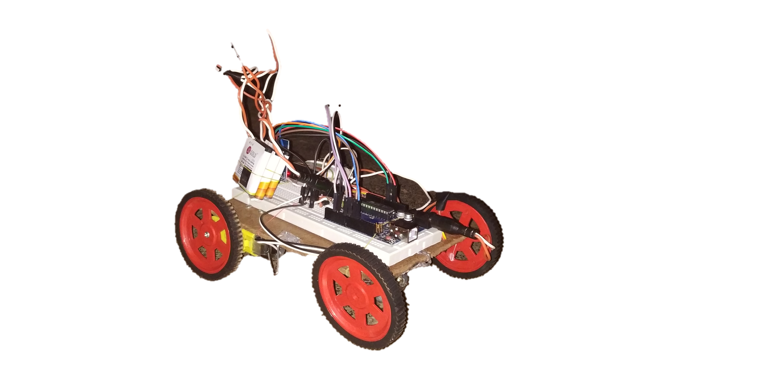

Hardware control via voice assistance

Slide 2
ABSTRACT
Implemented project based on Software interface.
Software Interface allows hardware to accept command Wirelessly in form of Voice.
Now-a-days Android is most popular.
90% of People use Android Smartphones.
So, We have decided to provide application Interface in Android through which user can send command wirelessly in form of voice.
Our project is mostly helpful for Handicapped and Illiterate People .

Slide 3
OBJECTIVES
Implement a Hardware device using Arduino Microcontroller which will receive commands via wireless communication.
Develop a program in Arduino Software which will allow that device to receive wireless commands and perform actions based on that commands.
Develop an Android application interface to control the device by sending commands via wireless communication.

Slide 4
COMPONENTS
Android Mobile Phone.
Bluetooth Module (HC05).
Arduino UNO R3.
Motor Driver Module L293.
DC Motors(9v).
Jumper Wires.
Batteries (12 V, 8 V).
Breadboard.

Slide 5
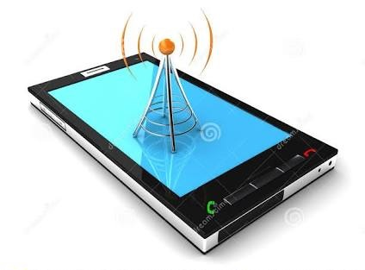
Android Mobile Phone
Android Mobile provides features like Bluetooth and WIFI.
Bluetooth & WIFI transmits and receives data wirelessly.
So, We are using Bluetooth communication of mobile phone in our project to send voice commands to the Bluetooth module HC05.
We are using Android Application Interface to provide this facility.

Slide 6
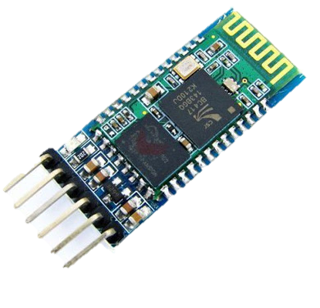
Bluetooth Module HC05
Bluetooth module is connected wirelessly to the Mobile phone.
And connected physically to the Arduino.
Module has 6 pins :-
ENM - Enable
5V - 5 Volt
GND - Ground
TX - Transceiver
RX – Receiver
STATE

Slide 7
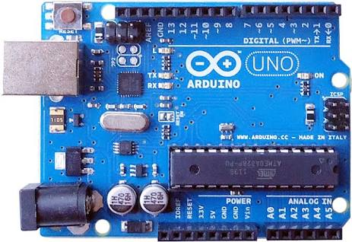
Arduino UNO R3
Arduino is an Open-source physical computing platform based on a simple microcontroller board.
Arduino can be used to develop interactive objects, taking inputs from a variety of switches or sensors and controlling variety of lights, motors and other physical outputs.
It simply connect it to a computer with a USB cable or power it with a AC-to-DC adapter or battery to get started.

Slide 8
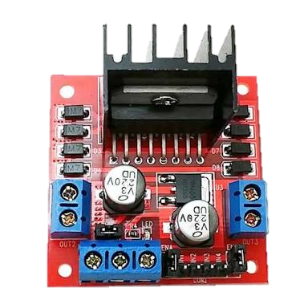
Motor Driver Module
L293
Motor Driver Module L293 is Dual Motor Controller Module 2A with Arduino.
This allows your to control the speed and direction of two DC motors.
There is also an onboard 5V regulator, so if your supply voltage is up to 12V you can also source 5V from the board.

Slide 9
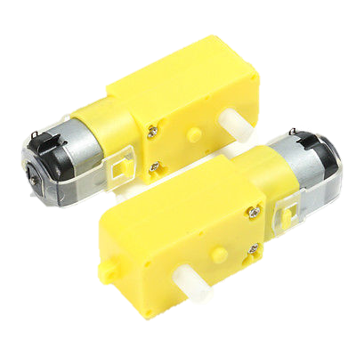
DC Motors
A machine that converts dc power into mechanical energy is known as dc motor.
Its operation is based on the principle that when a current carrying conductor is placed in a magnetic field, the conductor experiences a mechanical force.

Slide 10
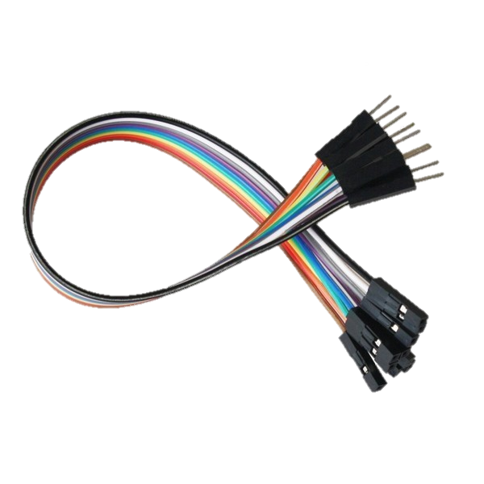
Jumper Wires
A jump wire is an electrical wire or group of them in a cable with a connector or pin at each end, which is normally used to interconnect the components of a breadboard or other prototype or test circuit, internally or with other equipment or components, without soldering.
Individual jump wires are fitted

Slide 11
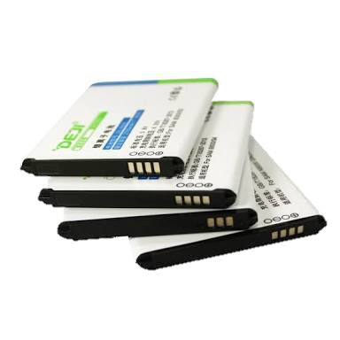
Batteries
We have used 1050mAh 3 batteries to form 12 V and 900mAh 2 batteries to form 8 V.
These batteries are serially connected to each other.
12 v supply is provided to Motor Driver Module and 8 V supply is provided to Arduino.

Slide 12
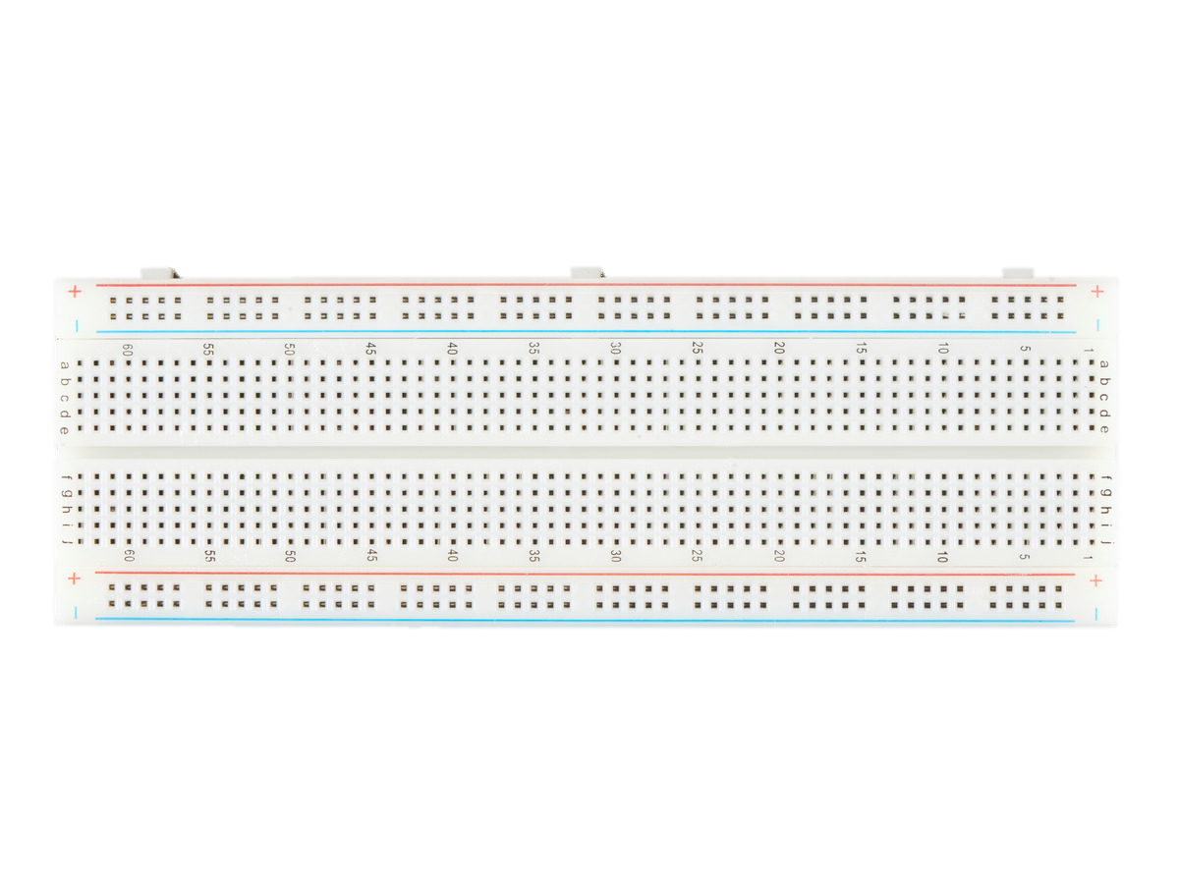
Breadboard
A Breadboard is a solderless device for temporary prototype with electronics and test circuit designs.
Most electronic components in electronic circuits can be interconnected by inserting their leads or terminals into the holes and then making connections through wires where appropriate.

Slide 13
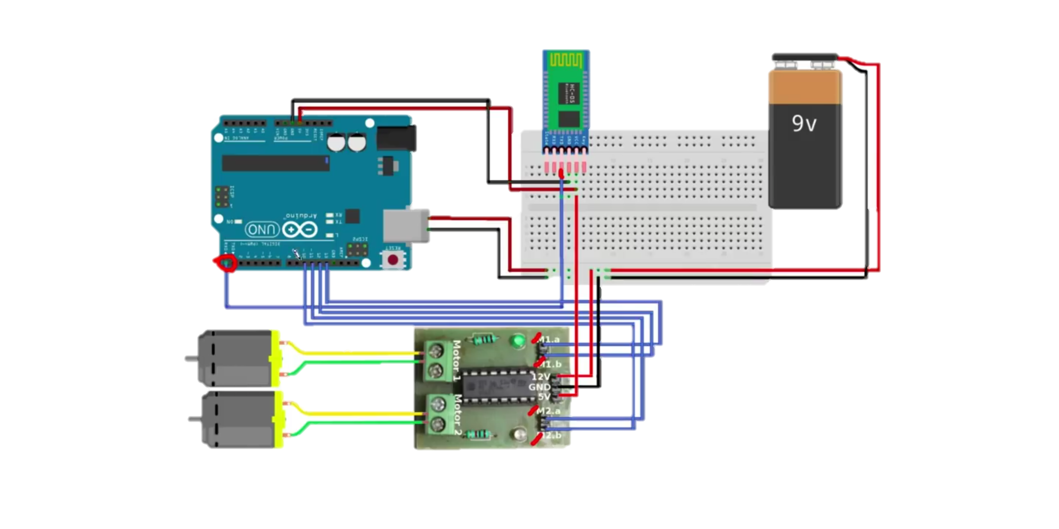
Connection of Model

Slide 14
APPLICATIONS
Control at your Voice Assistance.
Energy Efficiency.
Reduce Human efforts and time.
Ease of accessibility for illiterate and handicapped people.
Home automation based on voice assistance.
Improvement in safety and actions of accidental situations using talkback and voice assistance.
Multitasking from a particular distance.
Interface for all Android Users.

